Slide 1
Chapter 3. Data Models

Slide 2
This Lecture
The Relational Model
Relational data structures
ER diagram
Notation

Slide 3
The Relational Model
Introduced by E.F. Codd in his paper
“A Relational Model of Data for Large Shared Databanks”, 1970
The foundation for most (but not all) modern
database systems
Model covers data:
Structure
Integrity
Manipulation

Slide 4
Relational Data Structure
Data is stored in
relations (tables)
Relations are made up of attributes (columns)
Data takes the form of
tuples (rows)
The order of tuples is not important
There must not be
duplicate tuples
Relation
John | 23
Mary | 20
Mark | 18
Jane | 21
Tuples
Attributes

Slide 5
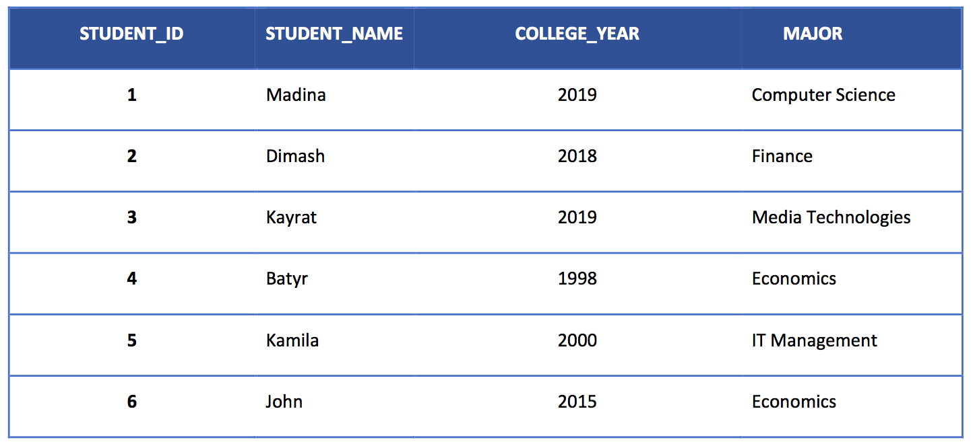
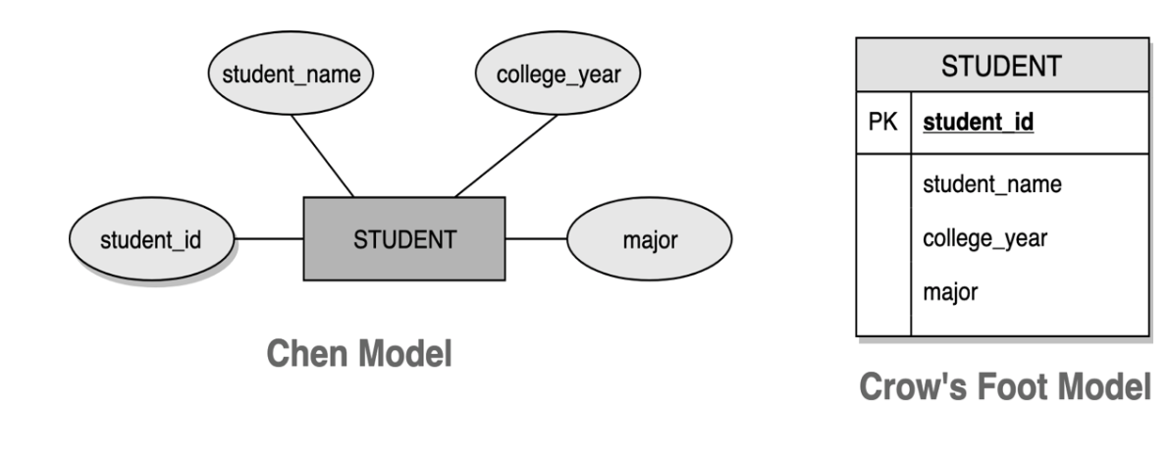
Data Model Basic Building Blocks
Table STUDENT Sample The attributes of the STUDENT entity:
Chen and Crow’s foot

Slide 6
Relations
We will use tables to represent relations
This is an example relation between people
and email addresses:
Aygerim | aaa@iitu.kz
Bolat | bbb@iitu.kz
Cammy | ccc@iitu.kz

Slide 7
Relations
In general, each column has a domain, a set from
which all possible values for that column can come
For example, each value in the first column below comes from the set of first names
Aygerim | aaa@iitu.kz
Bolat | bbb@iitu.kz
Cammy | ccc@iitu.kz

Slide 8
Relations
A mathematical relation is a set of tuples: sequences of
values. Each tuple represents a row in the table:
Andrew | aaa@cs.nott.ac.uk | 0115 911 1111
Bill | bbb@cs.nott.ac.uk | 0115 922 2222
Christine | ccc@cs.nott.ac.uk | 0115 933 3333
Aygerim | aaa@iitu.kz
Bolat | bbb@iitu.kz
Cammy | ccc@iitu.kz
• {<Aygerim, aaa@iitu.kz, 01159111111>,
<Bolat, bbb@iitu.kz, 01159222222>,
<Cammy, ccc@iitu.kz, 01159333333>}

Slide 9
Terminology
Degree of a relation: how long each tuple is, or
how many columns the table has
In the first example (name, email), the degree of the relation is 2
In the second example (name, email, phone) the degree of the relation is 3
Degrees of 2, 3, ... are often called Binary, Ternary, etc.
Cardinality of a relation: how many different
tuples there are, or how many rows a table has

Slide 10
Relationship
Relationship – it describes an association among entities
A 1:1 Relationship might be - One department has one head
- One key can open only one lock
A 1:M Relationship might be
- One department has many professors
- Bank client can own many credit cards
A M:N Relationship might be
- Many students have many classes
- Many store branches sell many products

Slide 11
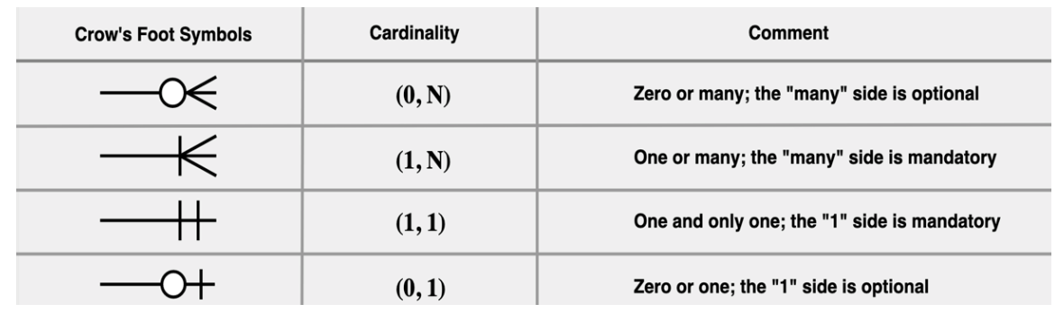
Relationship
Crow’s Foot Symbols

Slide 12
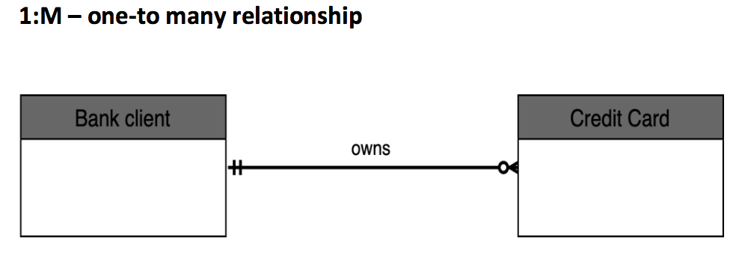
Relationship

Slide 13
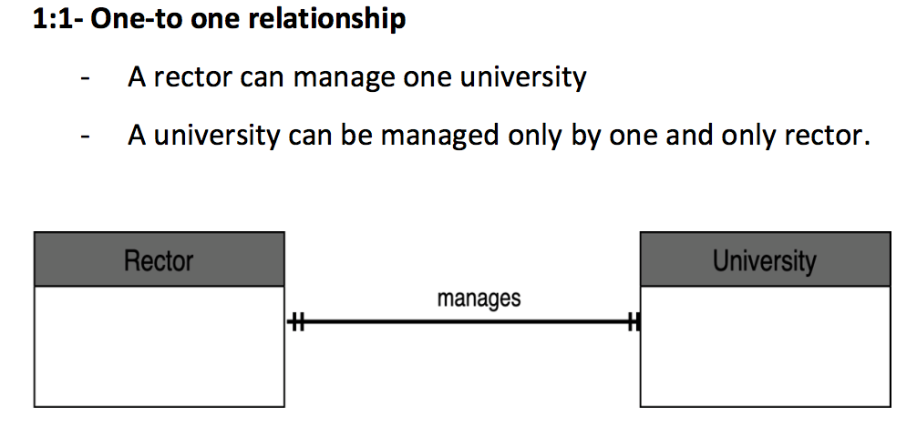
Relationship

Slide 14
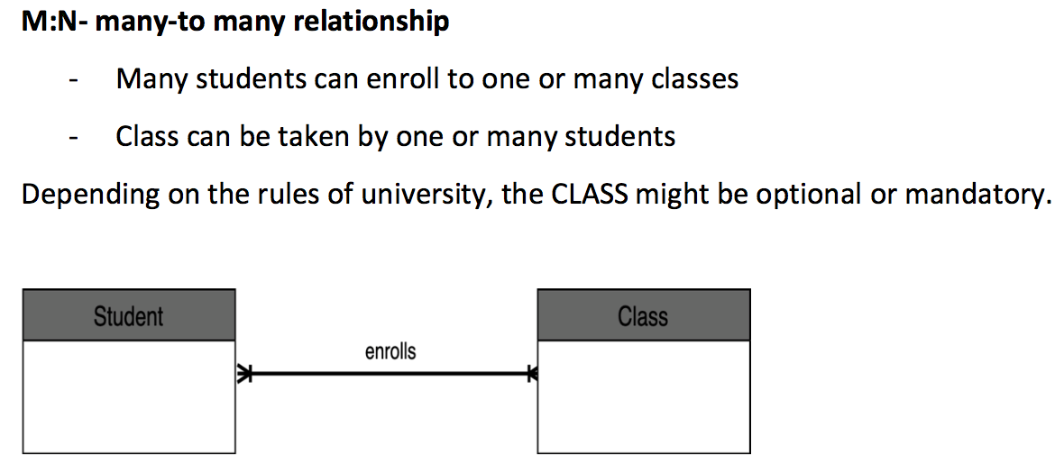
Relationship

Slide 15
Keys
A DMBS key is one ore more attributes that identify each row in the table. They allow to find the relation between two or more keys. Each row in the table must uniquely identifiable. The DBMS has the seven types of keys, but within this course we will discover the needs and roles of Primary and Foreign keys.

Slide 16
Primary Key
Primary Key (PK) is an attribute of the table that UNIQUELY identifies every row in that table. Its super impossible to have two rows in the table within same primary key values.
- A primary key value could not be a NULL.
- PK’s function is to guarantee entity integrity.
- PK doesn’t allow to appear the same value more than once. The single PK must be in a table.

Slide 17
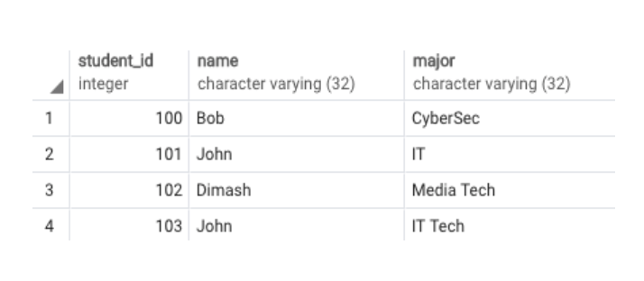
Primary Key
Table created for student entity
In this table, primary key values uniquely identify each row

Slide 18
Foreign Key
Foreign key (FK)
It is a field in the table whose values match the primary key of related table.
It may accept multiple null values.
It might be many foreign keys in a table.
NULLS:
Values are not always known.
No data entry.
Not permitted in primary key.

Slide 19
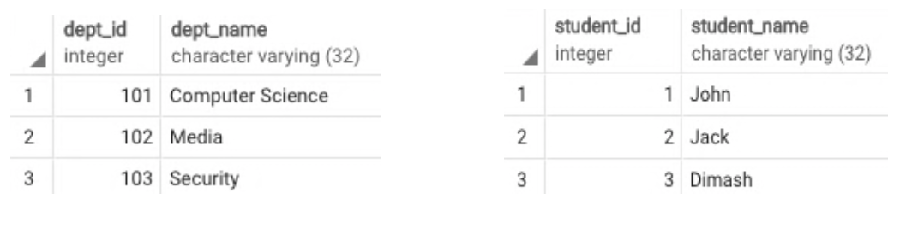
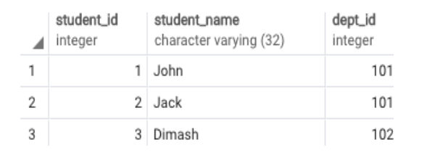
Foreign Key
Student & Department tables
The following figure shows that tables “department” and “student” are not related with each other to see which student is assigned to which department in the school.
"Student" table assigned with PK & FK keys

Slide 20
Relational Model
The Relational Model
Table (relations)
- Matrix consisting of row/column intersections.
- Each row in a relation is called a tuple.
Relational database management system (RDBMS)
- Performs same functions provided by hierarchical model.
- Hides complexity from the user.
Relational diagram
- Representation of entities, attributes, and relationships.
- Relational table stores collection of related entities.

Slide 21
Entity relationship diagram (ERD)
- Uses graphic representations to model database components.
- Entity is mapped to a relational table.
- Entity instance (or occurrence) is row in table.
- Connectivity labels are types of relationships.
- Relationships are expressed using Chen notation
Relationships are represented by a diamond
Relationship name is written inside the diamond

Slide 22
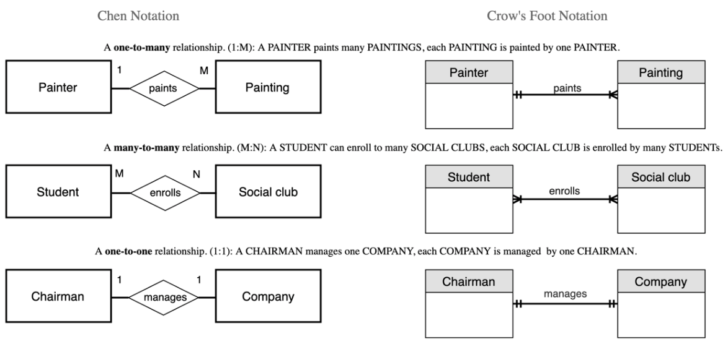
The ER model notations

Slide 23
Thank you for your attention!

